Slide 1

Structure of
Park Managements with Role Models
May 2, 2023

Slide 2

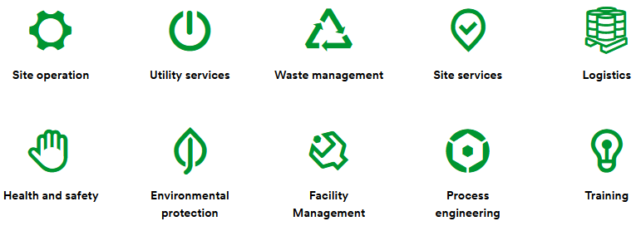
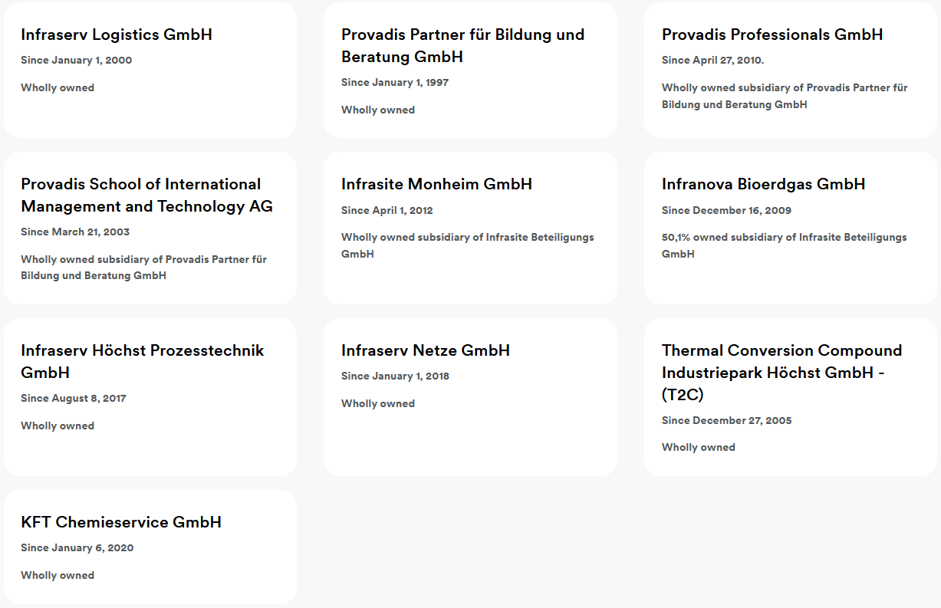

Example Germany:
Infraserv Höchst Group
Infraserv Höchst Group
Divisions
Subsidiaries
    The Infraserv Höchst Group has around 2,800 employees and 205 vocational trainees.
    In 2021, Infraserv Höchst and its subsidiaries generated approx. 1,1 billion Euro in revenues.

Slide 3



Example Germany:
Currenta-Organization as of January 2023
CURRENTA Board of Management
Site
Energy
Circularity
Logistics
Chemion GmbH
Maintenance
Tectrion GmbH
    Site security, fire safety, emergency services and environmental monitoring
    Infrastructure: Roads, railway lines, port facilities, pipe bridges
    Analytics
    Industrial IT (Fiber optic cable)
    Services
    ▪ Training
    ▪ Permits
    ▪ Building and land services
    ▪ Health protection
    ▪ Occupational safety
    ▪ Service Development
    Electricity and steam
    Compressed air
    Provision of technical gases
    Regulated Grids, Electric & Gas Grids
    Pipeline Networks
    Wastewater discharge and treatment
    Water supply
    Refrigeration
    Disposal of waste and waste air
    Landfill sites
    Collection centers for recyclable material
    Rail Logistics
    Container Logistics
    Freight Forwarding
    Port Logistics
    Logistics Services
    Production Logistics
    General-Cargo Logistics
    Operational maintenance
    Maintenance of machines
    Technical facility management
    Engineering services
    Consulting services for innovative maintenance solutions
    Electrical engineering/installations
    Welding and testing technology
    Measurement and calibration services
    Group Functions (Finance, Controlling, HR, Communications, Procurement, IT, …)

Slide 4

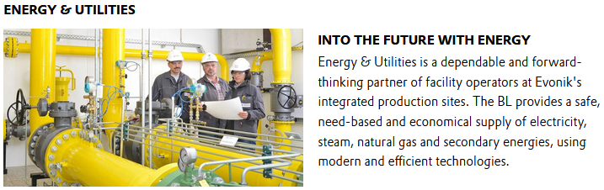
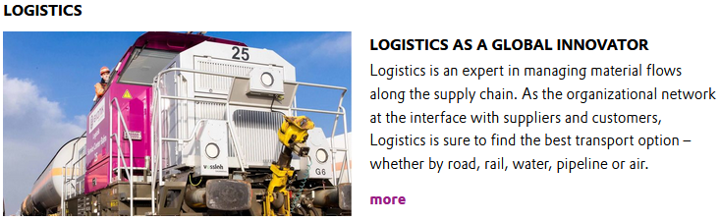
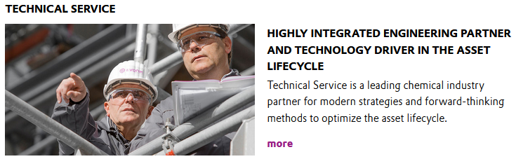
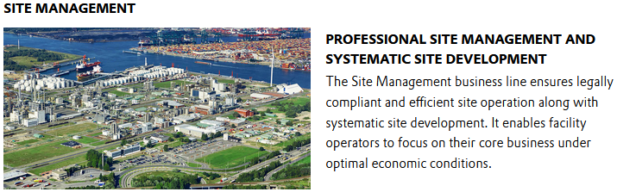
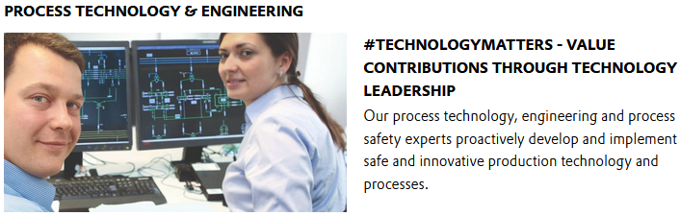
Example Germany:
Evonik Technology and Infrastructure
Evonik Division „Technology & Infrastructure“ Business Lines
    Provision of electricity and gases
    Supply of process steam, cold, heat, water
    Disposal of waste, wastewater, exhaust gases
    Storage facilities
    Factory railway
    Transmission Networks
    Port operations
    Forwarding Services
    Ensuring the availability of production plants
    Development of maintenance strategies
    Maintenance
    Calibration
    Assembly
    Inspection
    Revision
    Rapid elimination of malfunctions
    Development, planning and construction of pilot and test plants and special devices
    Health
    Safety
    Work and occupational safety and health
    Managing authorities and Events
    Facility Management
    Catering
    Development of new processes
    Optimization of existing processes
    Worldwide construction of chemical plants
    Individual technology consultancy
    Recruiting and development of engineers
    Cooperation with universities

Slide 5


Example Germany:
Pharmaserv-Organization
Pharmaserv Managing Directors
Site Management
Technics
Logistics
    Facilities
    Utilities
    IT Solutions
    Site Services
      health and safety,
      waste disposal,
      catering,
      environmental protection
      mobility
    Innovation Engineering
    Project Engineering
    Module and Type Qualification
    Equipment Asset Services
    Pharmaceutical Storage
    Transport Logistics
    Production Supply
    Pharmaserv Shop
    Group Functions (Finance, Controlling, HR, Communications, Procurement, IT, …)

